Slide 1
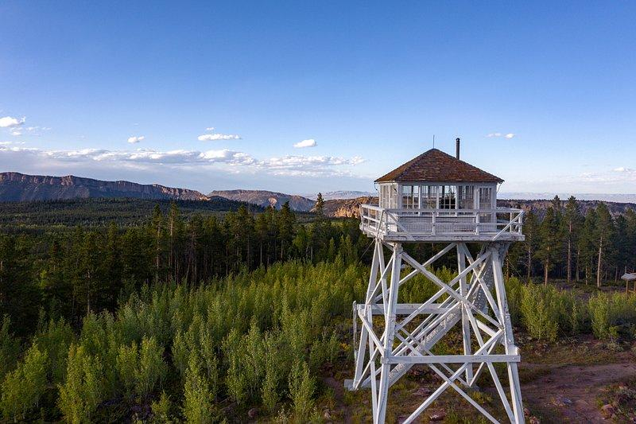
Inferno Insights: A Real-Time Comparative Analysis of Fire Weather Indices and Active Wildfire Data
By: Alex Gerwer, Jeremy Rosario, Tavneet Kaur

Slide 2
Introduction
This project examines how fire risk indices provide a comprehensive, real-time analysis of wildfire risk in a specific geographic region (e.g., California) by comparing three distinct fire weather indices: the Canadian Forest Fire Danger Rating System (CFFDRS) and Fire Weather Index (FWI), the National Forest Fire Danger Index (FFDI), and the modified Fosberg Fire Weather Index (mFFWI).
Using these three indices, an interactive data visualization that overlays the three indices on a map that also displays current fire locations, thus providing a clear and informative picture of real-time fire risk.
This visualization allows for the comparison of three fire indices in the context of the geographic regions where fires frequently occur.

Slide 3
Fire Risk Indices
CFFDRS (Canadian Forest Fire Danger Rating System): A complete system used in Canada, considering weather (temperature, humidity, wind) and fuel moisture to produce several indices, including the Fire Weather Index (FWI). FWI is a core component of CFFDRS, focusing on fire behavior potential.
NFDRS (National Fire Danger Rating System): The U.S. equivalent of CFFDRS. It also uses weather and fuel data to calculate various indices, most notably the Forest Fire Danger Index (FFDI). Like FWI, FDI indicates the potential for fire spread and intensity.
FFWI (Fosberg Fire Weather Index): A classic index using an exponential formula based on temperature and relative humidity. It provides a general indication of fire weather potential but doesn't account for wind or fuel moisture directly. Considered less sophisticated than FWI or FFDI.
mFFWI (modified Fosberg Fire Weather Index): An attempt to improve the FFWI by incorporating the Keetch-Byram Drought Index (KBDI). KBDI estimates drought conditions and fuel dryness.

Slide 4
Procedure
Data Acquisition: Weather and fire data is retrieved via APIs, focused on the LA county region.
Index Calculation: Python scripts, using libraries like pyfwi, pandas and numpy, calculate FWI, FFWI, and mFFWI based on weather data. KBDI is also calculated for mFFWI, and equilibrium moisture content (m) is computed as a supplementary indicator. The calculations for these indices are detailed in the references provided (see mFFWI.md, Canadian Forest Fire Weather Index (FWI) System.pdf, NRDS4_FDI.pdf).
Data Storage & Retrieval (with SQLAlchemy & SQLite): A local SQLite database (fire_weather.db/.cache.sqlite) is used for efficient storage and retrieval of fire weather indices. SQLAlchemy is employed for database interactions.
GeoJSON Processing & Filtering (with Shapely): Shapely is used to process and filter the GeoJSON data for California, extracting specifically Los Angeles County data for optimized performance and more focused visualization.
Visualization (with Folium & Leaflet): Folium, a Python library built on Leaflet.js, generates interactive maps. Color-coded overlays visualize spatial distribution of index values, and markers show active fires. Layer control is implemented for dynamic overlay management. Interactive elements allow date/time and geographic filtering.

Slide 5
Evolution of the Underlying Code
Initial Version for all California: This initial script fetches weather data, calculates fire weather indices (FWI, FFDI, mFFWI), and creates basic interactive maps using Folium. Coverage for all of CA resulted in a very long execution time.
Extracting LA County: This script focuses on efficiently extracting the Los Angeles County data from the larger California GeoJSON to improve performance of the mapping.
First & Second Versions - Combining Indices & Boundaries, Adding Colormaps & Legends:
First version: Integrates LA County boundary extraction into the main script and creates separate base maps for each index to avoid marker overlap.
Second version: Adds colormaps and legends for each index.
Final Versions - Template & Serialization Improvements: This version improves performance by using Jinja2 templates and custom JSON encoding for simplified JSON handling. Layer control is also added for interactive toggling of layers, as well as offsetting markers to enhance visibility. One version uses the creation and reuse of an SQLite database to store date stamps, latitude, longitude, weather data, and the three indices.

Slide 6
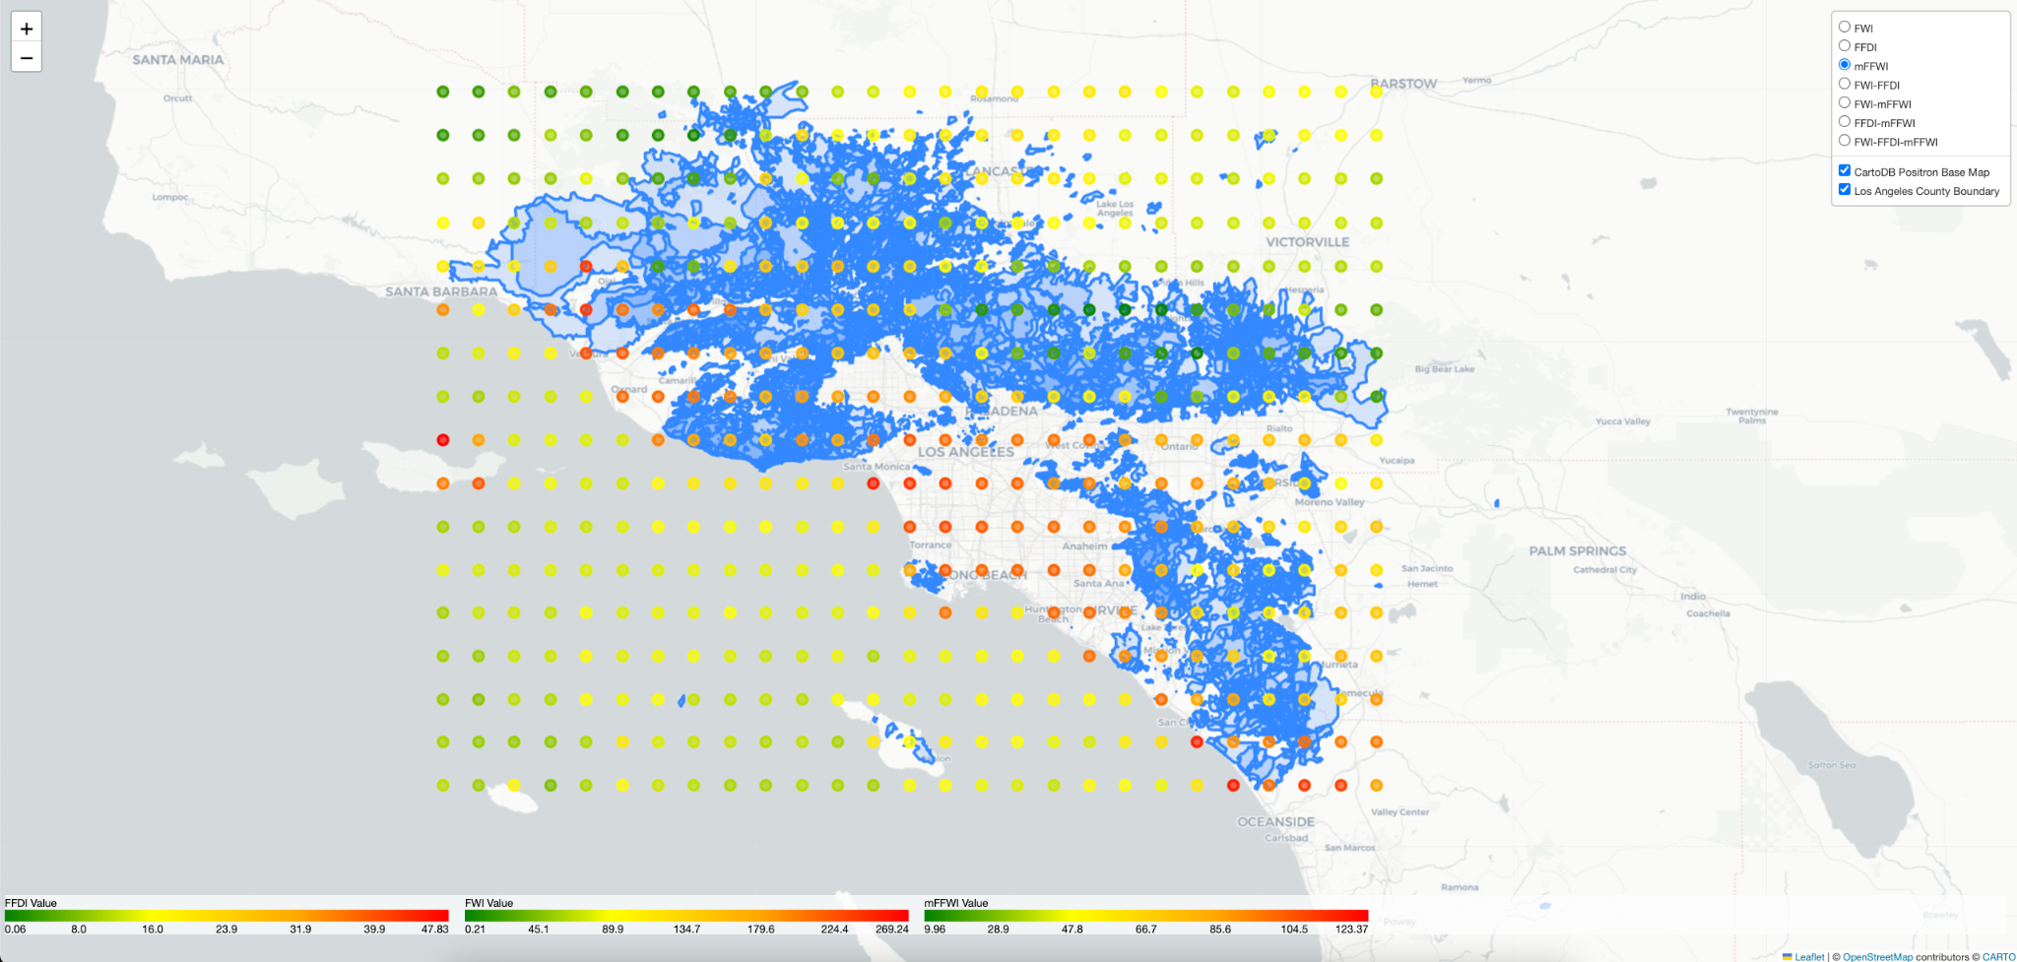
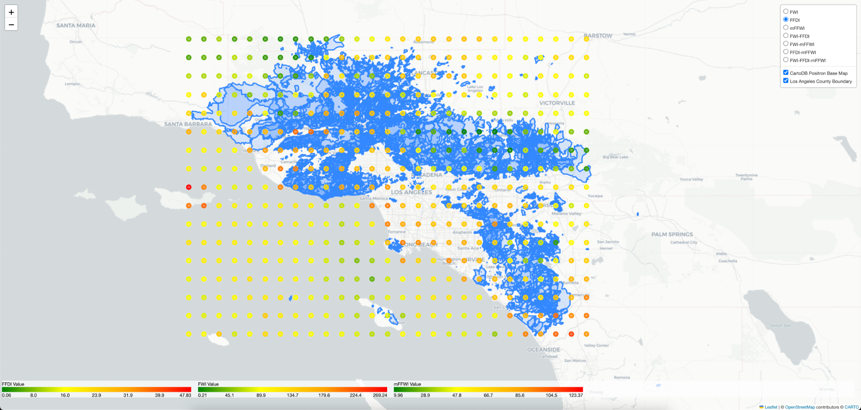
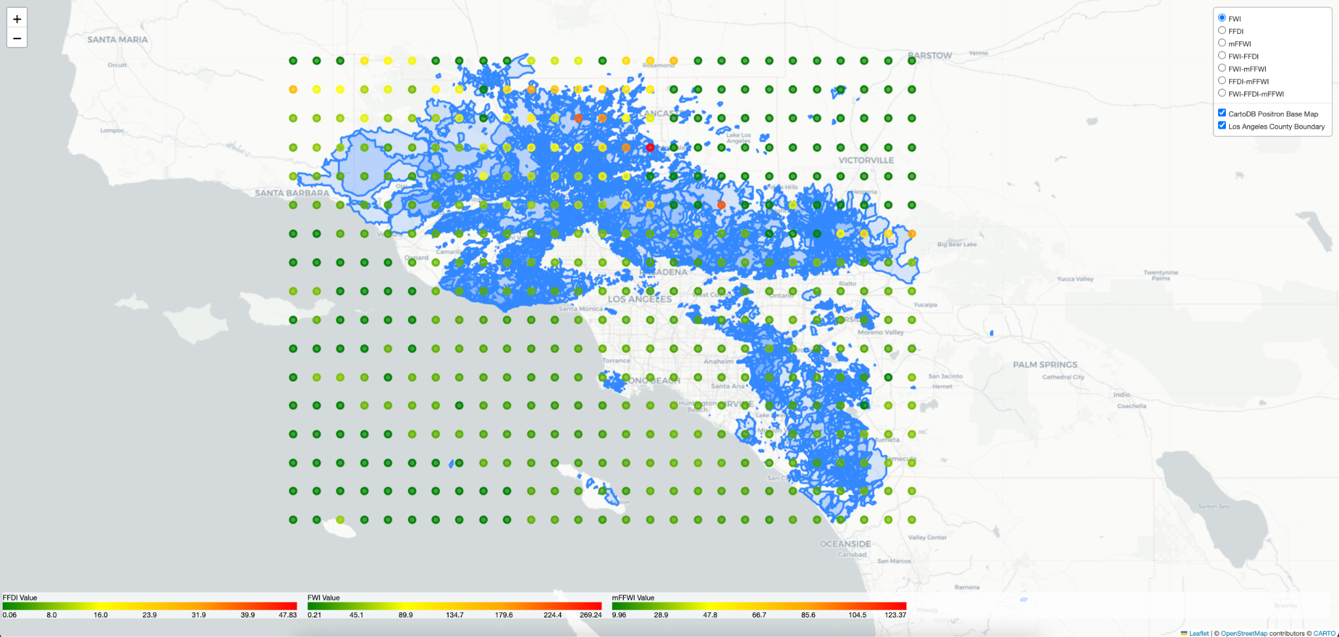
LA Fires: January 7th, 2025

Slide 7
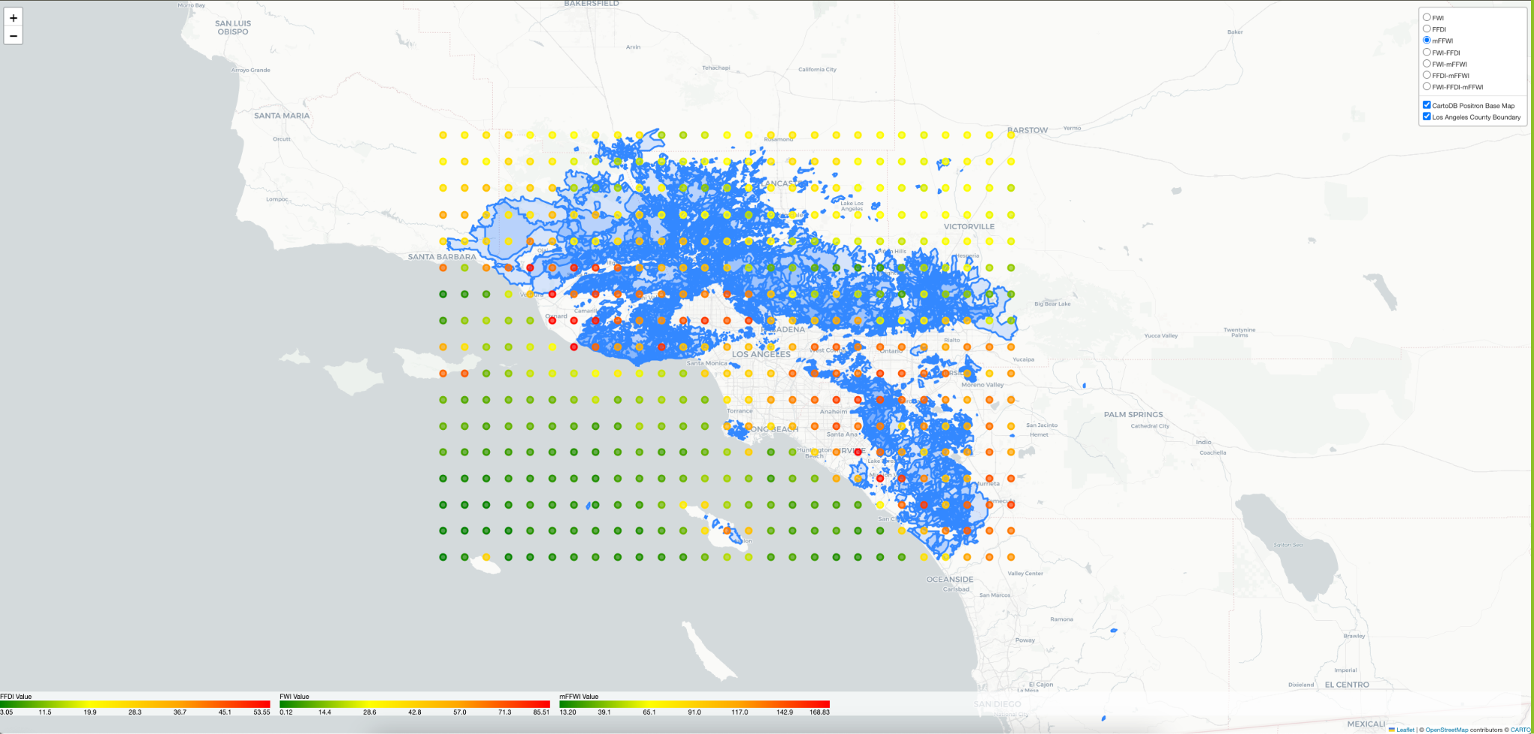
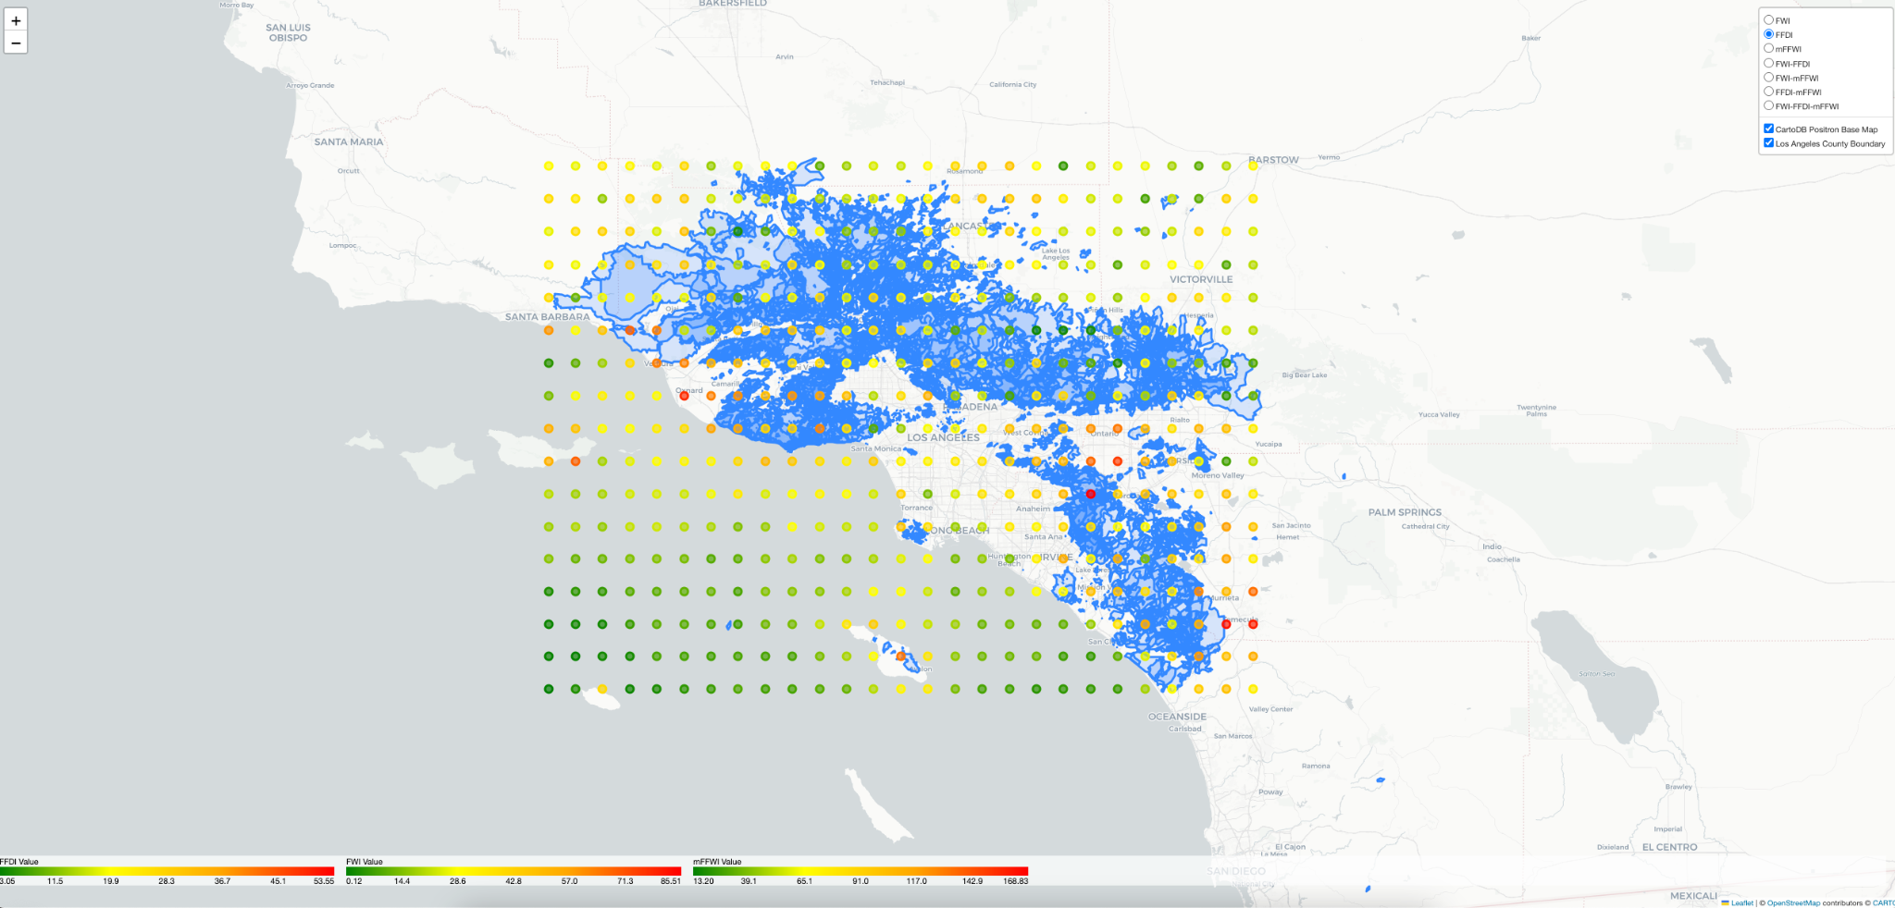
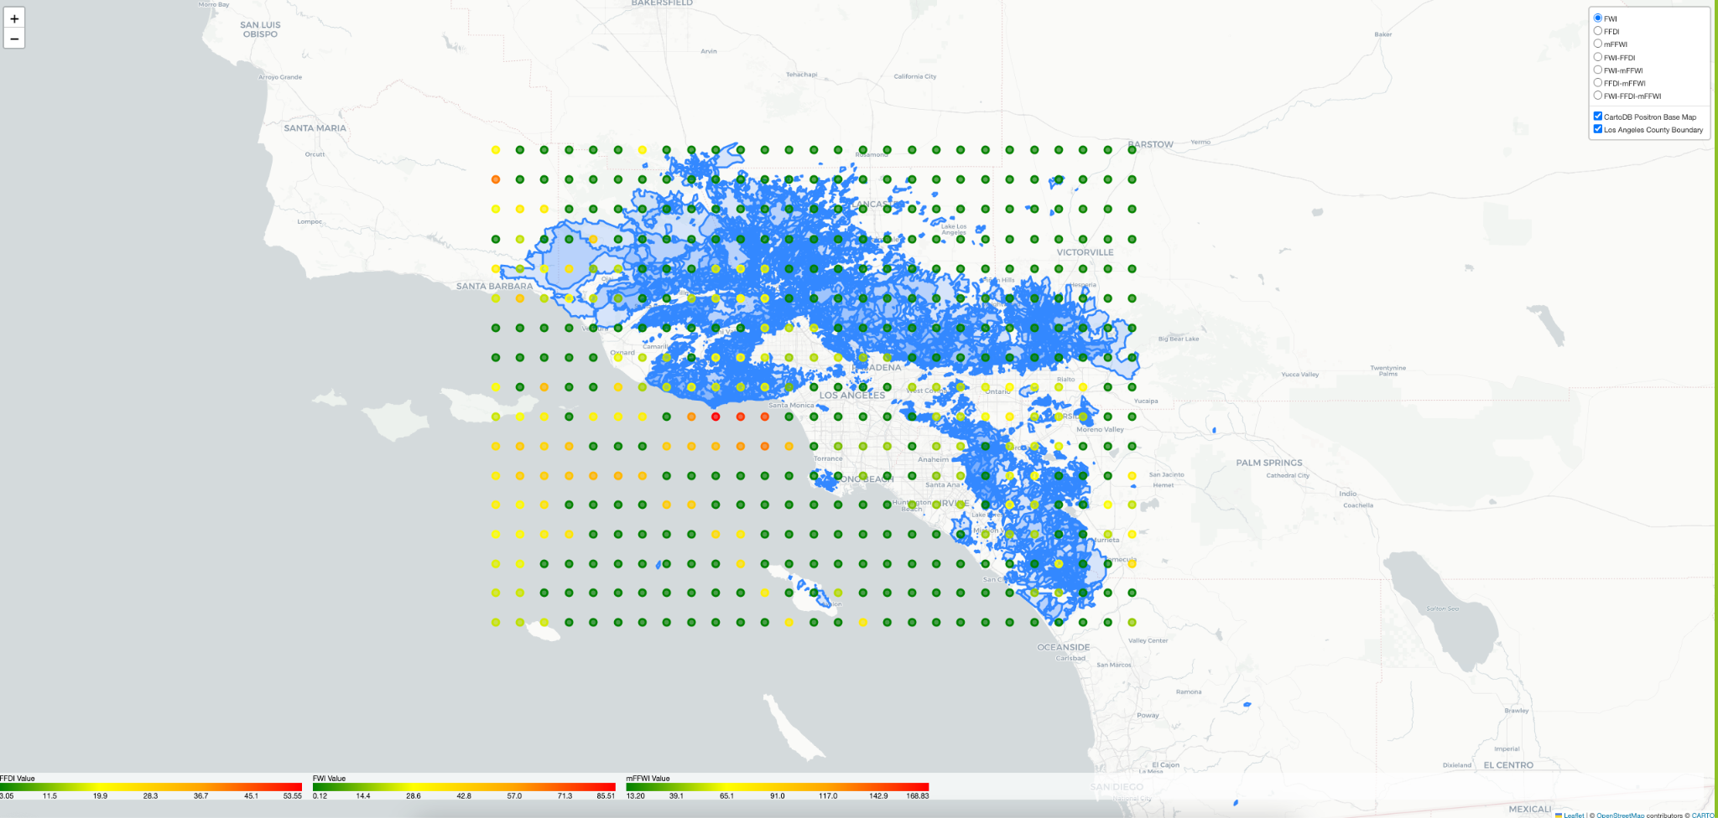
LA Fires: January 9th, 2025

Slide 8
Comparative Fire Indices Analysis
Note that the three fire indices are on very different numerical scales whose ranges have been matched to the same color range.
FFDI and mFFWI tend to provide very similar results when compensated for scale; FWI tends to provide a much less sensitive measure of forest fire danger. This may be because the FWI index was created for regions in Canada and the literature indicates that its sensitivity elsewhere is limited.
On January 7, 2025, when fires first started in Los Angeles County, the FFDI and the mFFWI indices both show elevated index values in the area of the fire.
On January 9, 2024, after the fires had been burning for a couple of days, all three indices clearly show elevated indices in the are of the first fire (Pacific Palisades), but mFFWI also shows elevated risk in the Altadena area as well.

Slide 9
Live Deployment via Github Pages
Key files were copied from the LA_Combined_Fire_Indices_Including_Fire_Boundaries_Combination_Markers_Final folder to the docs folder in the repository, particularly the fire_index_mapping_with_fire_boundaries_refined Jupyter Notebook with code reconfigured to generate a index.html file output
From the Inferno_Insights repository,
Select Settings
Pages in the left-hand column
Choose deploy from branch as source
Under branch, indicate the docs folder under the main branch
Site becomes live shortly thereafter

Slide 10
Future/Continued Implementations and Iterations
Calculations were successful, but could not fully take into account retrospective weather data which would require more complex iterative calculations
Computational Efficiency of the code has not been optimized, resulting in extended runtime executions.
Suspect that a hybrid index formed by combining the three indices in some manner would provide better performance than the separate indices.
The current code does not allow a user to specify a date other than the date at the time of use to be used.
With additional time, we would like to create a Live Flask WebApp to allow the user to specify the of the map to be rendered. Further would with Flask could enable county selection, thereby allowing the user to create fire index maps for geographical areas of their own choice.

